Slide 1
Credit Card Approval
Prediction
Group 4
Min Joo / Hoon /Shino / Fang Wei
Notes:
minjoo

Slide 2
CRISP-DM for problem-solving
1. Business
Understanding
Credit card approval prediction can not only benefit for bank and applicants
2. Data
Understanding
Collated the historical loan data and background info from previous applicants
2. Data
Preparation
Clean data, classify the good/bad applicants and do feature engineering
3. Modeling
Building
Modeling Data with logistic regression and Random Forest.
3. Testing
Evaluation
Compare 2 models
4.Development
Finding and overcoming the limitations of our project
2/28
Notes:
minjoo

Slide 3
01
Business
Understanding
3/28
Notes:
minjoo

Slide 4
Problem & Topic
Predictive Analytics
Credit card approval prediction by analyzing the credit card applicants’ data.
Help the bank, by minimizing the potential risks of issuing credit cards for unqualified applicants.
The credit card applicants know in advance whether they can pass the application to avoid credit score decline due to failure.
4/28

Slide 5
02
Data
Understanding & Preparation
5/28
Notes:
Based on the business understanding, now the next step is to do the data understanding & preparation

Slide 6
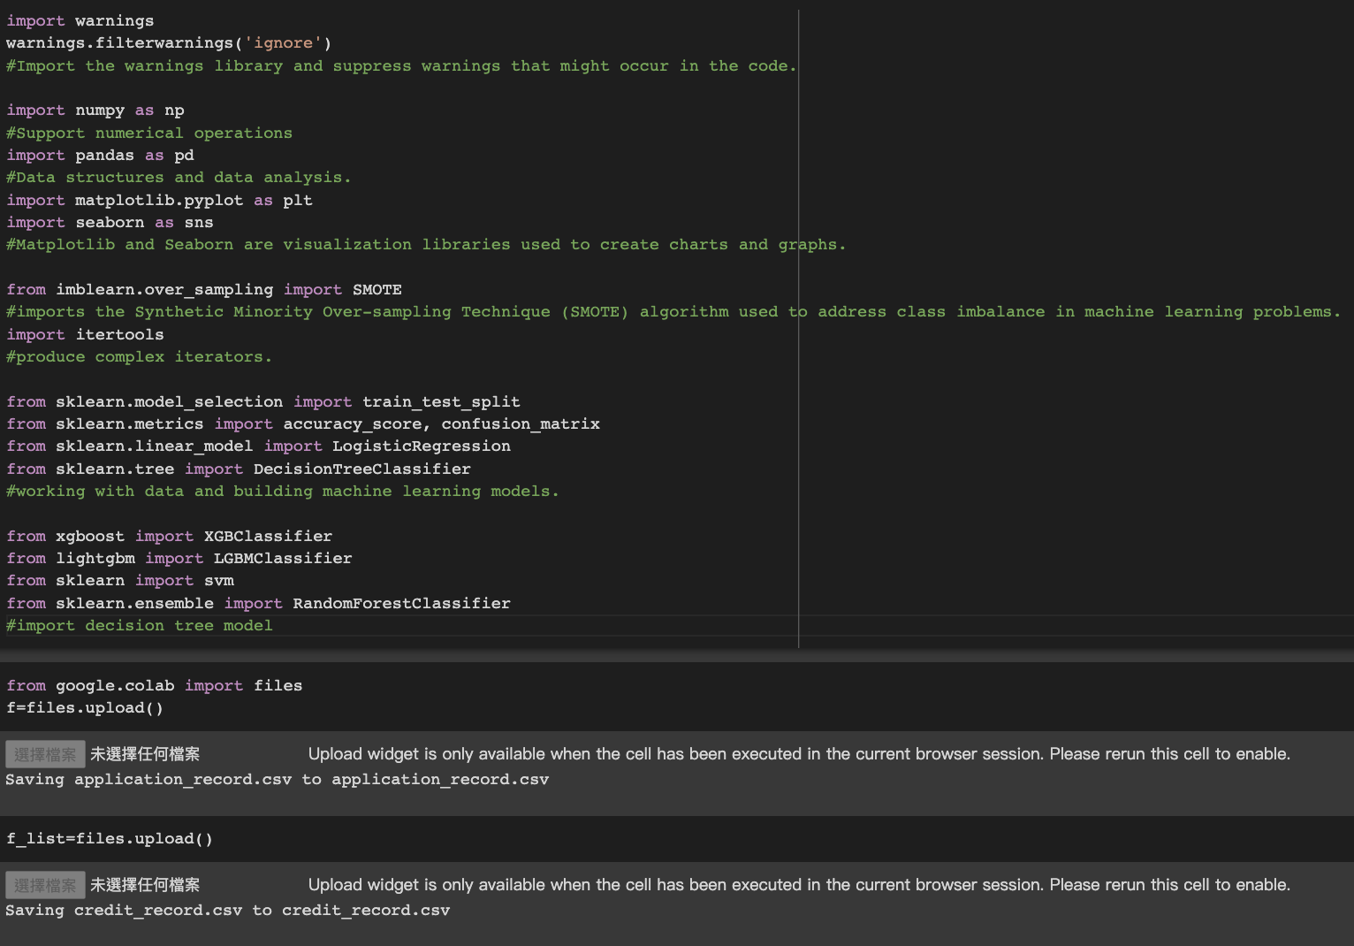
Prepare data and libraries
6/28
Import required libraries
Import data from files
Two dataframe
Personal background
Personal monthly credit status
Notes:
We decide to use Python.
First step we import all required libraries and two dataframes
The first one is personal background
and second one is personal monthly credit status.

Slide 7
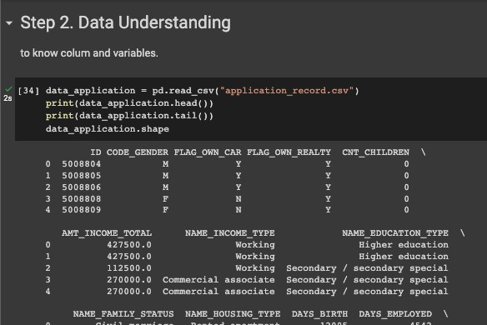
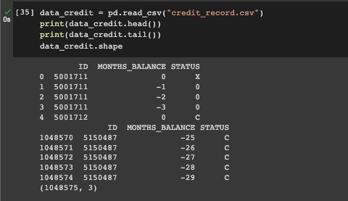
Data Understanding
Understand the
Credit_Record Dataframe
Understand the Application_Record Dataframe
7/28
Notes:
After import two data frame,
By using the head tail and shape code. We can get to know more about the size of each data frame, columns and variable.
So as i mentioned we have two dataframe, the left hand side the application record shows ID gender if they have car/ house or not.
And the opposite side shows the id in different month with different credit status.

Slide 8
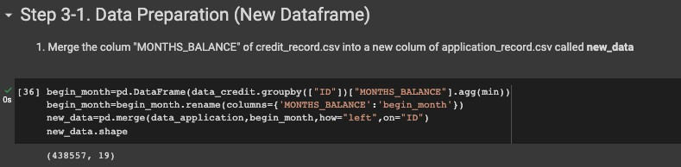
Data Preparation (New Dataframe)
the Credit_Record Dataframe
the Application_Record Dataframe
called new_data Dataframe after merging
MONTHS_BALANCE
ID | CODE_GENDER | FLAG_OWN_CAR | …….etc
8/28
Notes:
After know original dataframe, we need to make the data can be analysis after.
Therefore we calculate the amount of months_balance and merger to the application record as a new column, rename it as new_data dataframe

Slide 9
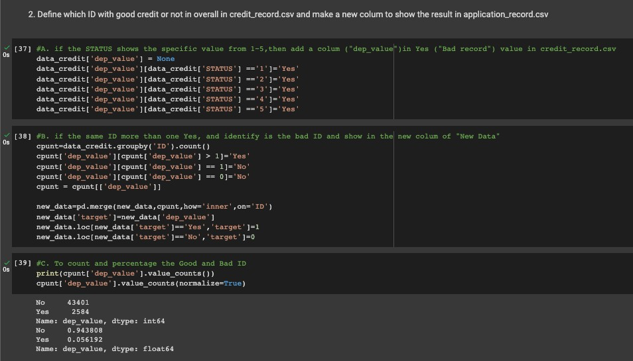
0: 1-29 days past due
1: 30-59 days past due mark as YES
2: 60-89 days overdue mark as YES
3: 90-119 days overdue mark as YES
4: 120-149 days overdue mark as YES
5: Overdue or bad debts, write-offs for
more than 150 days mark as YES
C: paid off that month
ID | MONTHS_BALANCE | STATUS
12345 | -3 | 3
9/28
Notes:
After that based on the credit status in each month, we mark 1-5 as YES

Slide 10


Feature Engineering
Identify Good ID or not & Merge to new dataframe
each more than 1 time YES
each less than or equal to 1 time YES
ID, Client number
STATUS
ID, Client number
STATUS
New column variable into the new_data Dataframe
ID | CODE_GENDER | FLAG_OWN_CAR | …….etc | MONTH_BALANCE
10/28
Notes:
So we make a new create valuable to count if each ID have more than 1 time YES, which means they are in bad status,
If each ID have less than or equal to 1 time YES, which means they are in good status.
And we will put the result into the new_data dataframe

Slide 11
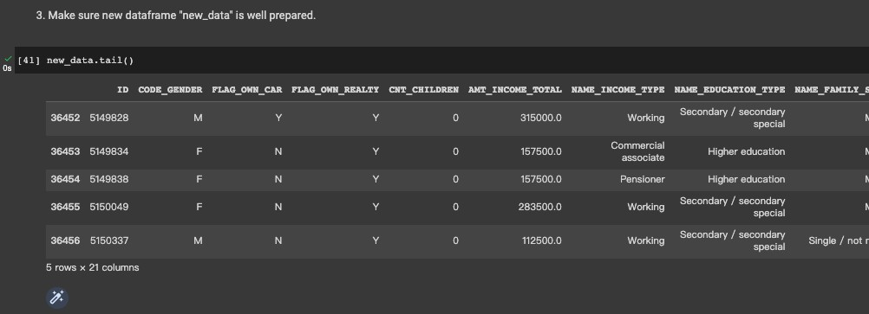
Check New_Data Dataframe is well prepared
11/28
Notes:
Then we will check the new_data frame is well_prepared.
We can see some of the data still in binary feature, some of variable are string .

Slide 12
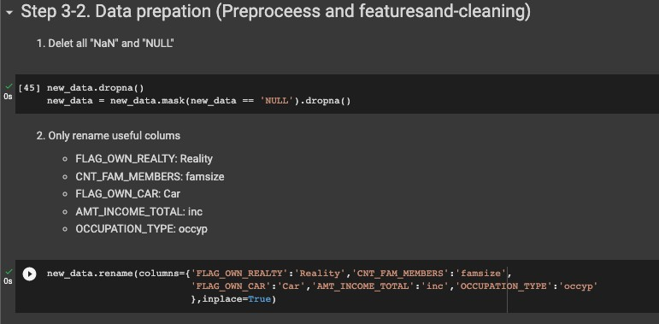
Data Preparation (feature-cleaning)
Delete “NaN” & “NULL”
House
Rename
‘ House ‘
12/28
Notes:
So we need to cleaning the data.
We deleet the nan and null data.
And rename columns to make they easy to type after.

Slide 13
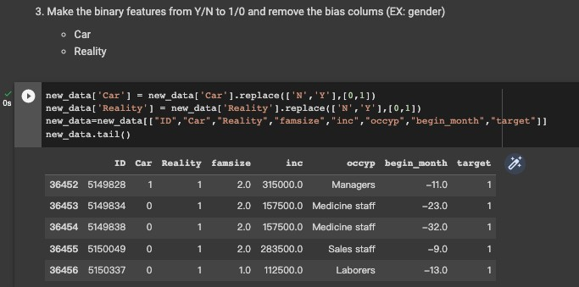
House
Change the binary feature from string Y/N to integer 1/0
“ House ”
“ House ”
Remove the bias or we believed is not relative columns
13/28
Notes:
And we select the binary features from sting Y.N to 1/0
After that we remove that we believ is bias or is not relative column to make the data simple.

Slide 14
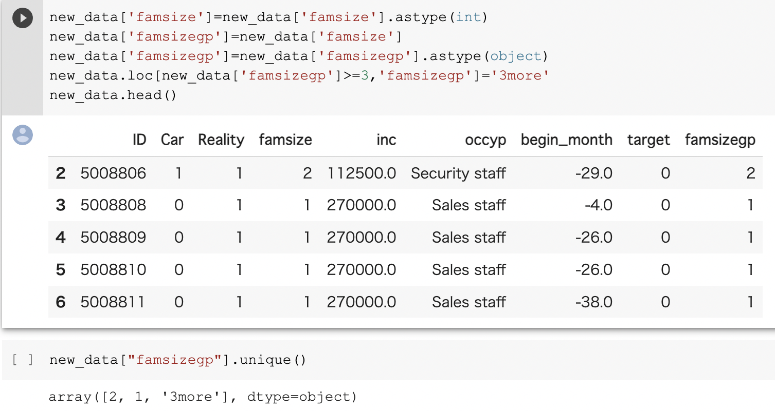
Continuous variable - dummy
Understand the data type & rename
14/28
（１）The number of family members
Manipulation operation, called
‘new_data’ to create the new columns
House
*New column*
famsizegp_1, famsizegp_3
Divide into 3 groups

Slide 15
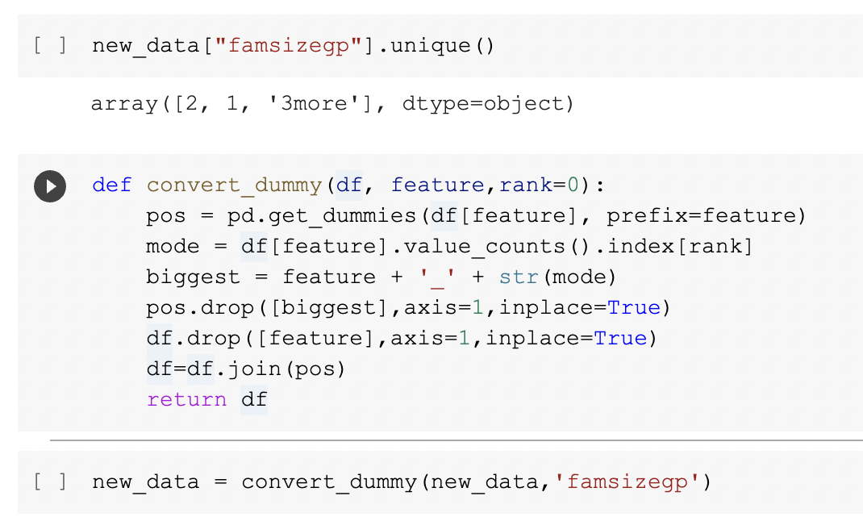
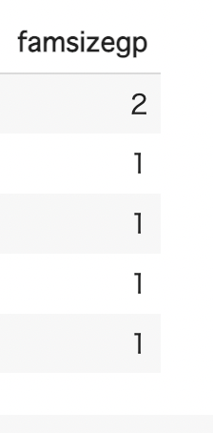
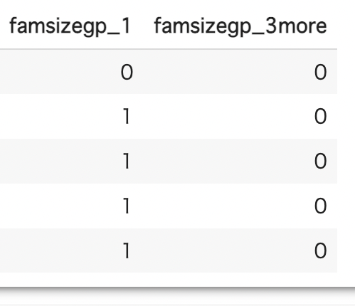
the family member is described as followings
1… 1 0
2… 0 0
3… 0 1
15/28

Slide 16
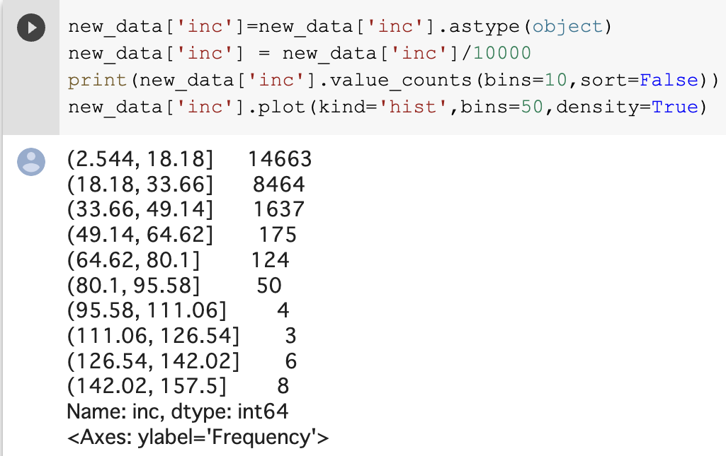
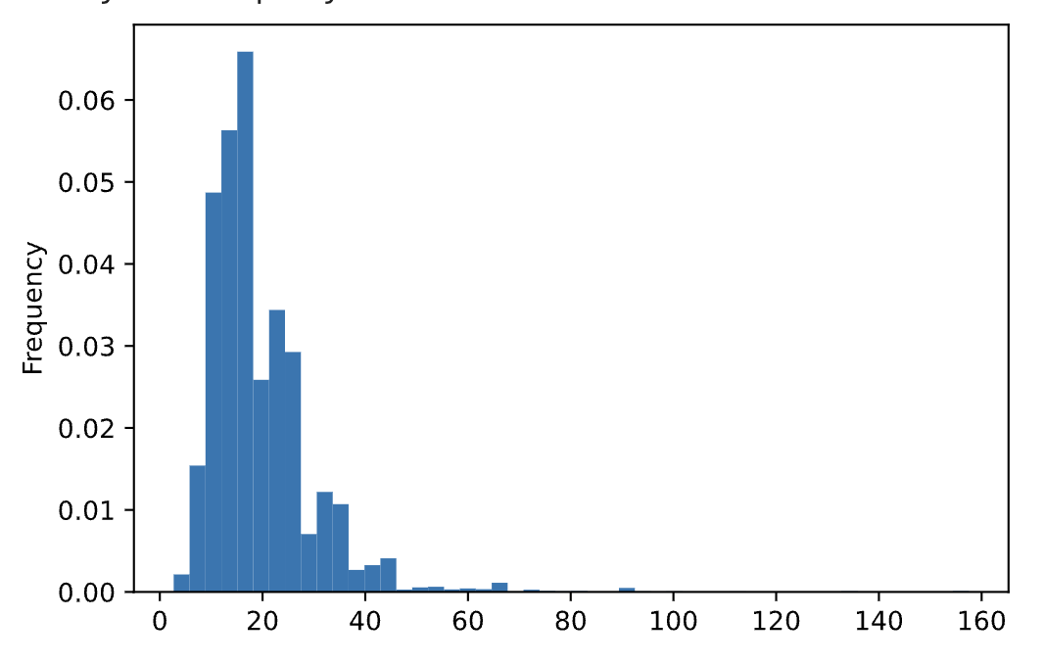
Visualize the data - dummy
to know which range of income is the most frequent number
‐
（２）Income range
The most frequent range
25K ~ 181K
16/28

Slide 17
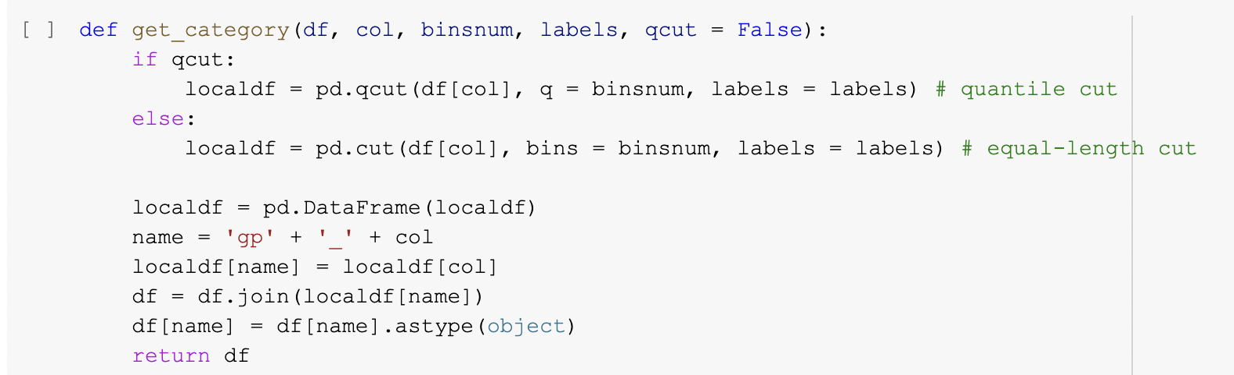
Visualize the data - dummy
to know which range of income is the most frequent number
divided the income level into 3 groups
# quantile cut
Using qcut() function,
the data is divided into 3 equal parts that we decide
#equal - length cut
Used so that the width of bins are equally divided
17/28

Slide 18
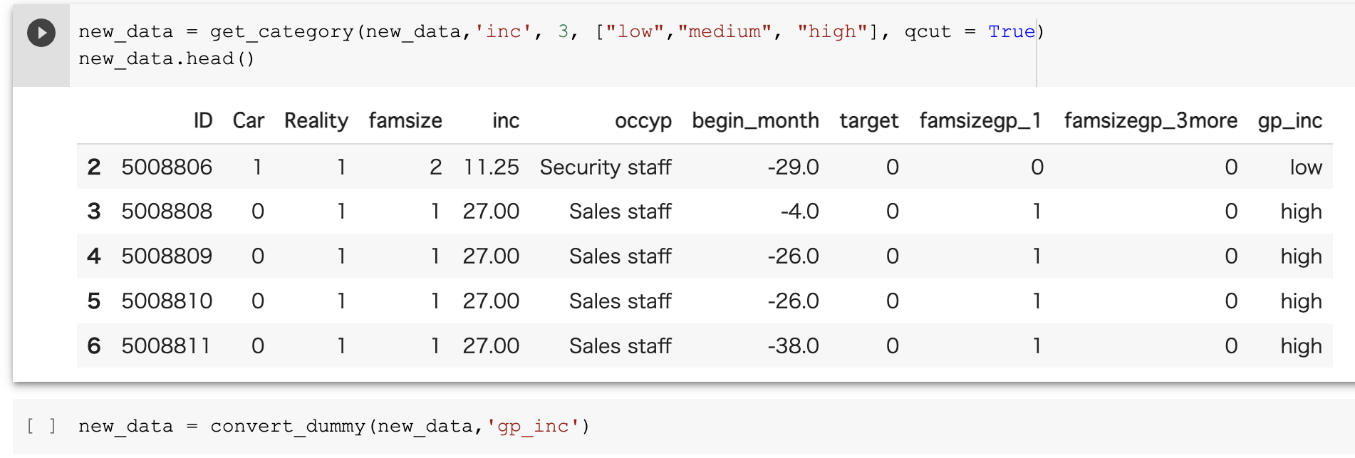
This process helps us ensure that each category has a roughly
equal number of observations.
House
Split into three categories based on the values of the ‘inc’ (income)
‘Low’, ‘medium’, ‘high’
18/28

Slide 19
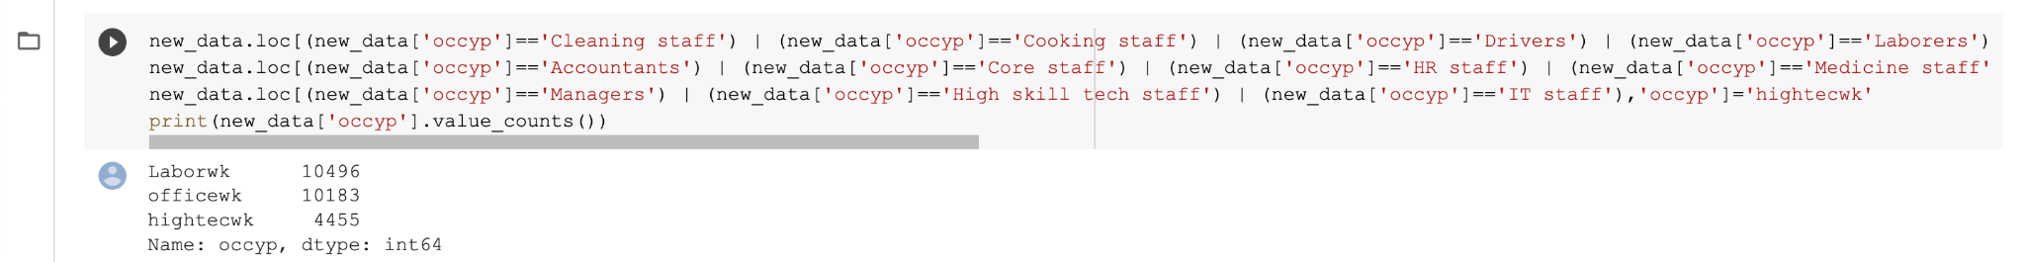
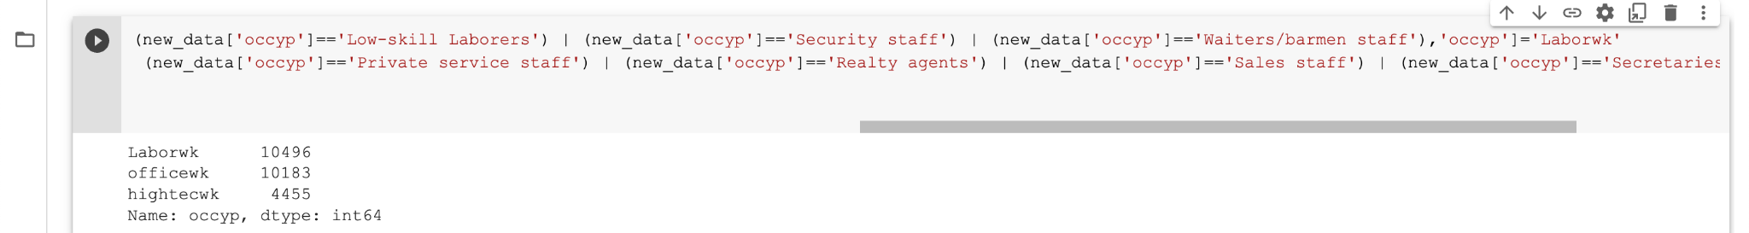
Categorical variable
( 3 )Occupation
Categorize types of occupation
Because of the various types of occupations, narrowed down to 3
19/28

Slide 20
03
Model Building /
Test & Evaluation
20/28

Slide 21
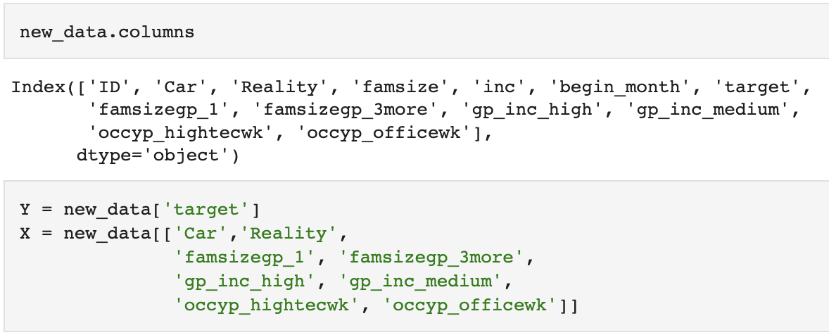
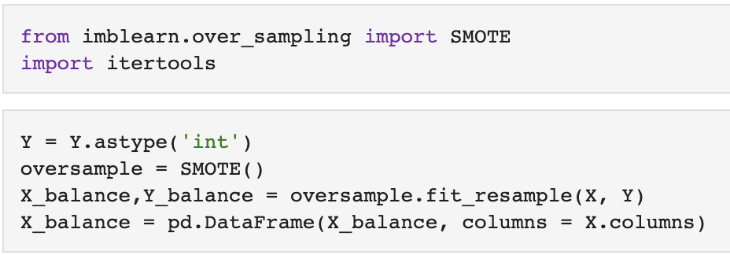
Address Imbalance Dataset - SMOTE
21/28
New dataset :
Define Y and X variables
Addressing imbalanced datasets by oversampling the minority class.
Synthetic Minority Oversampling Technique (SMOTE)
Notes:
The challenge of working with imbalanced datasets is that most machine learning techniques will ignore, and in turn have poor performance on the minority class, although typically it is performance on the minority class that is most important. So we are addressing our imbalance dataset by oversampling the minority class by using SMOTE in python.

Slide 22
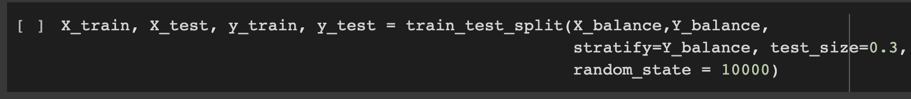
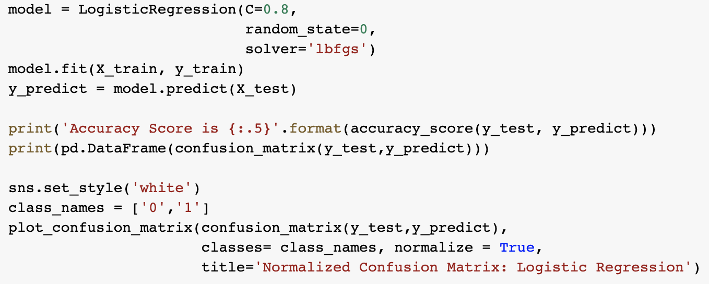
Logistic Regression - Confusion Matrix
22/28
Split the data into train & test
Logistic Regression
Notes:
We split the data into x train, x test - and y train, y test and then performed a logistic regression.
logistic regression - type of statistical model - often used for classification and predictive analytics.
Logistic regression estimates the probability of an event occurring, based on a given dataset of independent variables.

Slide 23
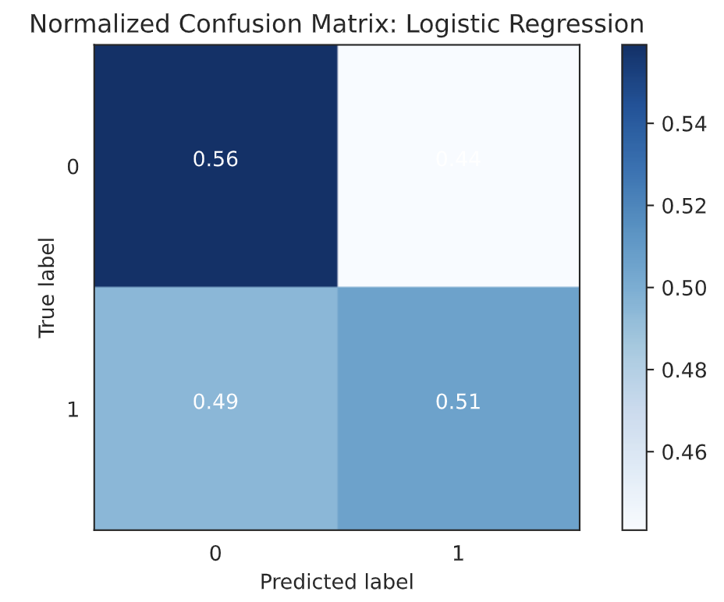
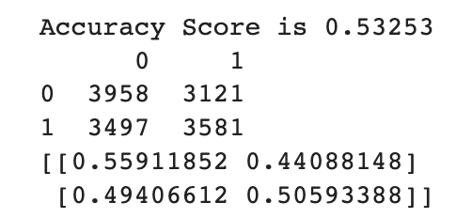
Logistic Regression - Confusion Matrix
23/28
Notes:
On the left is a confusion matrix of the logistic regression. It’s a table that defines, visualize and summarizes the performance of a classification algorithm.
On the right is our accuracy score - we got a score of .53

Slide 24
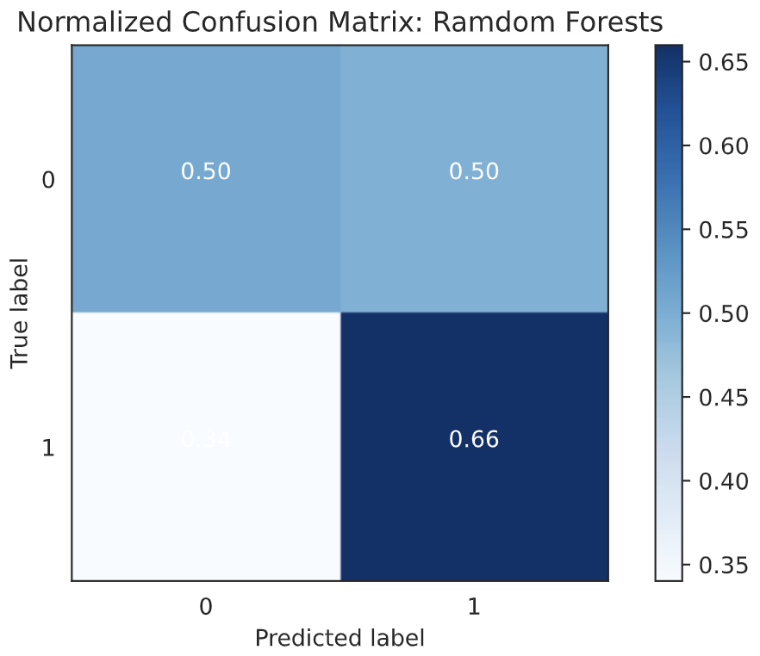
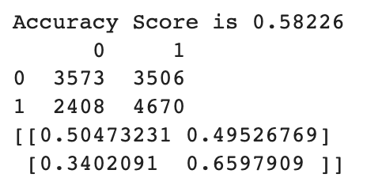
Random Forest Classifier
24/28
Notes:
We also used the Random Forest Classifier model to test and predict our data.
The random forest algorithm is basically a model that’s made up of a collection of decision trees and it can be used to solve for regression or classification problems.
And our accuracy score came out to be 0.58 which is a slightly better score than logistic regression, but still very low.

Slide 25
04
Development
25/28

Slide 26
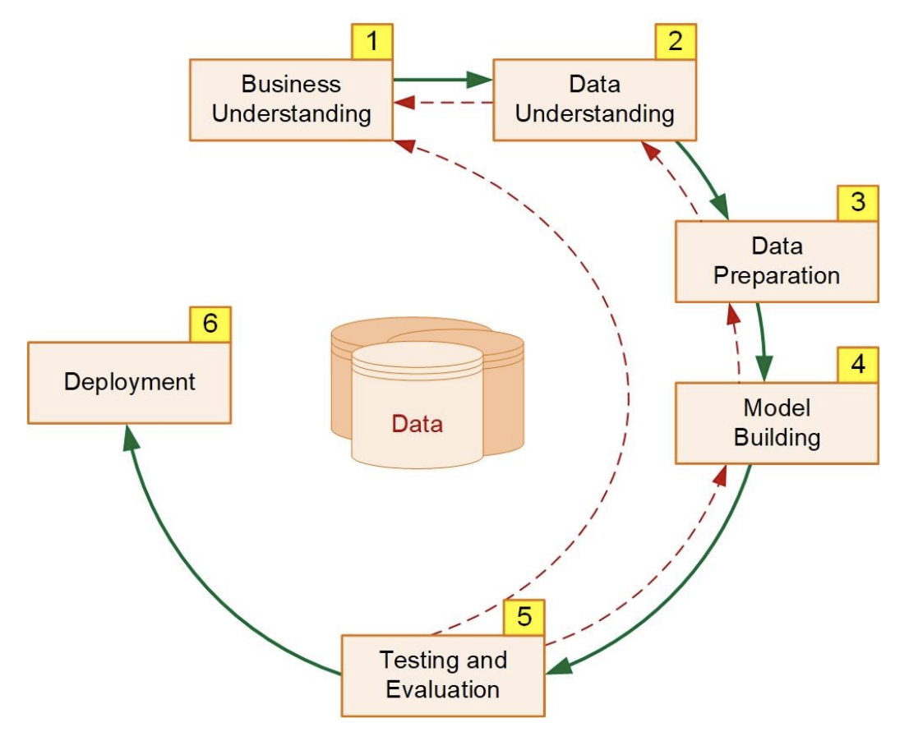
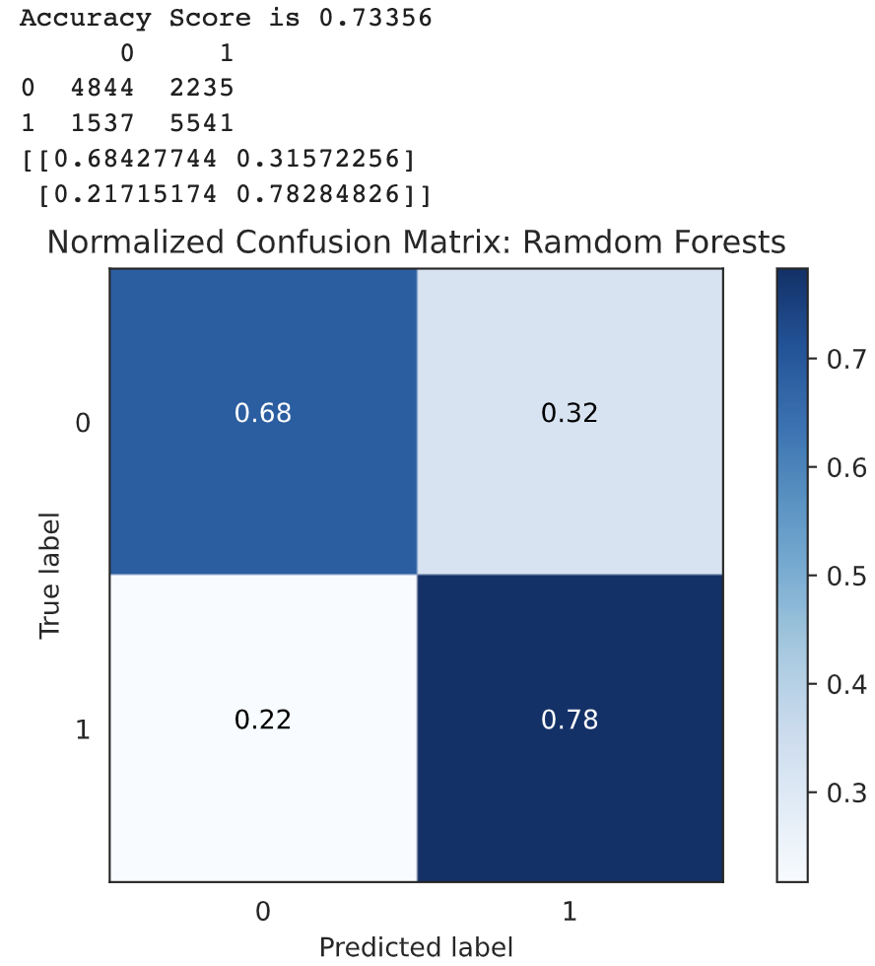
Development - Improvements
After evaluating the result, we concluded that the results are invalid.
In order to improve our accuracy score,
we can revisit the steps from 1 to 4 on CRISP-DM before deployment.
26/28
Notes:
After evaluating the results, we concluded that the accuracy score is too low and and therefore the results are invalid.
So what we can do to improve this is by revisiting the steps from 1 to 4 on the CRISP-DM methodology.
When we added more features to the code and performed the Random Forest model again, our accuracy score improved upto 0.73.

Slide 27
Summary
Credit Card Approval Prediction
By analyzing the credit card applicants’ data
CRISP - DM
Cross Industry Standard Process for Data Mining Methodology
Data Preparation
Cleaning / New Dataframe / feature engineering
Model Building
Logistic Regression & Random Forest
Evaluation
Improving accuracy score
Constraints : Time limitation
27/28

Slide 28
Thank You
Q & A
28/28

